Slide 1


Criminal Database Management System
MINI-DATABASE MANAGEMENT PROJECT
PRESENTATION ON
Internal Guide
Mrs. Ayesha Noorain
Designation
Dept. of AIML
KNSIT
Presented by
Farha Fathima Harshitha Jaganath
1KN21AI010 1KN21AI011 1KN21A012 1KN21AI013

Slide 2
Contents
Abstract
Introduction
About Python and SQL
Literature Survey
SQL Database Description
Back-end design
Front-end design
Outcomes
Future Enhancement
Conclusion
References

Slide 3
Abstract
The Criminal Database Management System (CDBMS) is a user-friendly and efficient solution designed to streamline the management of criminal records.
The system ensures the database's accuracy and reliability by allowing for the addition of new criminals, quick searches for specific individuals, record updates, and removal of outdated data.
The integration of MySQL as the backend database and Python as the programming language provides flexibility, scalability, and easy maintenance.

Slide 4
Introduction
Efficiently manages data, ensuring integrity and security.
Utilizes Python for flexible and rapid system development.
Integrates SQL for efficient data manipulation and querying.
Facilitates quick access to critical criminal information.
Enhances effciency in law enforcement and legal proceedings.
Adapts to evolving needs with scalable architecture.
Continuous improvement planned for future enhancements.

Slide 5
About Python and SQL
Python is the main language making the Criminal Database Management System (CDBMS) user-friendly.
Python's simplicity helps create an easy-to-use interface for law enforcement.
SQL, specifcally MySQL, is used to store, retrieve, and manage criminal data efficiently.
SQL ensures data accuracy by enforcing rules defined during the database setup.
Python and SQL together provide a powerful & straightforward solution for managing criminal records.

Slide 6


Literature Survey
Scope of the Project
The project aims to develop a Criminal Database Management System (CDBMS) to streamline the management of criminal records.
Scope includes ensuring database accuracy and reliability by incorporating features for data validation and integrity.
Integration of MySQL as the backend database and Python as the programming language provides flexibility, scalability, & easy maintenance.
The project scope extends to enhancing efficiency in criminal investigations through centralized and organized data management.

Slide 7
Literature Survey
Review of Existing System
Functionality: Evaluate the system's core functionalities, such as data input, retrieval, and update. Assess the system's ability to handle diverse types of criminal data.
Database Design: Examine the database structure, normalization, and indexing. Evaluate the efficiency and organization of the data model.
Security Measures: Review the implemented security mechanisms, including encryption and access controls. Check for vulnerabilities and assess the system's resilience against unauthorized access.
Biometric Integration: Evaluate the accuracy and reliability of biometric technologies integrated into the system. Consider the system's adaptability to emerging biometric advancements.

Slide 8
Literature Survey
Technologies Used:
tkinter: Python's standard GUI library for creating graphical user interfaces. It provides tools for building windows, buttons, labels, etc.
SQlite3: A standalone command-line shell program called sqlite3 is provided in SQLite's distribution. It can be used to create a database, define tables, insert and change rows, run queries and manage an SQLite database file. It also serves as an example for writing applications that use the SQLite library.

Slide 9
SQL Database Description
This database stores information about criminals involved in various crimes. Each criminal entry includes details such as their name, gender, nationality, age, height, weight, the crime they conducted, and a description providing additional information about the individual.
The 'id' field serves as a unique identifier for each criminal record. The 'name' field stores the name of the criminal, while 'gender' indicates their gender. 'Nationality' records the nationality of the criminal, while 'age' stores their age in years.
The 'description' field allows for a more detailed paragraph about the criminal, potentially containing up to 10 lines of text. This database facilitates the storage and management of data related to criminal activities, aiding law enforcement agencies and judicial systems in tracking and apprehending perpetrators.

Slide 10
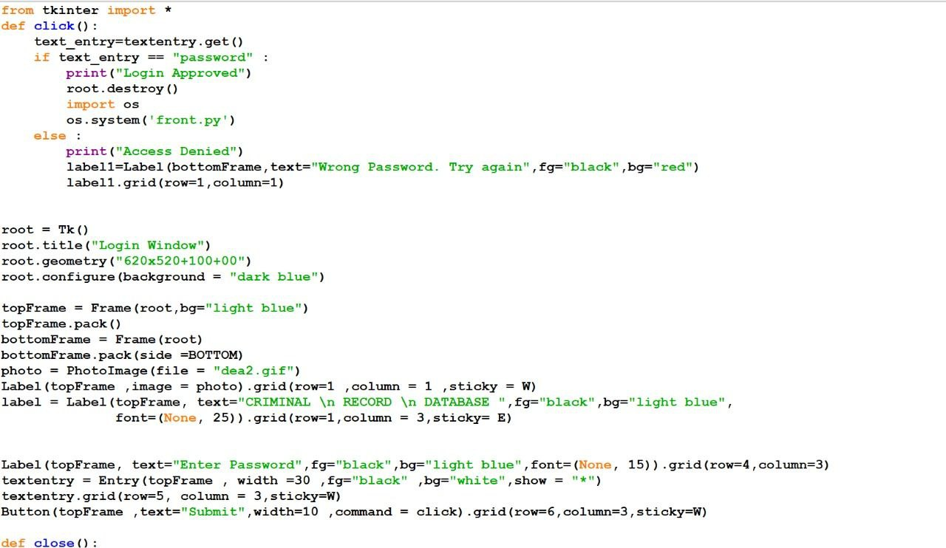
Front-end design
The code uses Tkinter, a Python library, to design a graphical user interface for an admin login page.
It incorporates functions to manage button clicks, window closure, and user interaction elements such as labels, buttons, and entry fields.

Slide 11
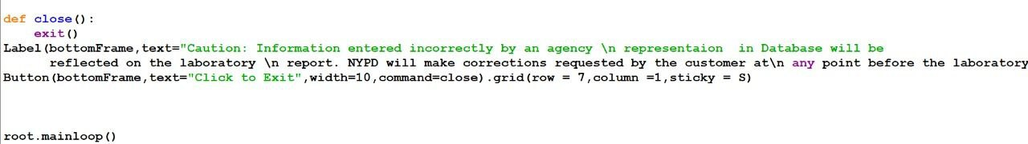
Front-end design
The code establishes a program exit function (`close()`) and initializes the main Tkinter window with specific attributes.
It structures the window with frames, loads an image, and adds user interaction elements, including labels, an entry widget, and a submit button, with a caution message and an exit button in the bottom frame.

Slide 12
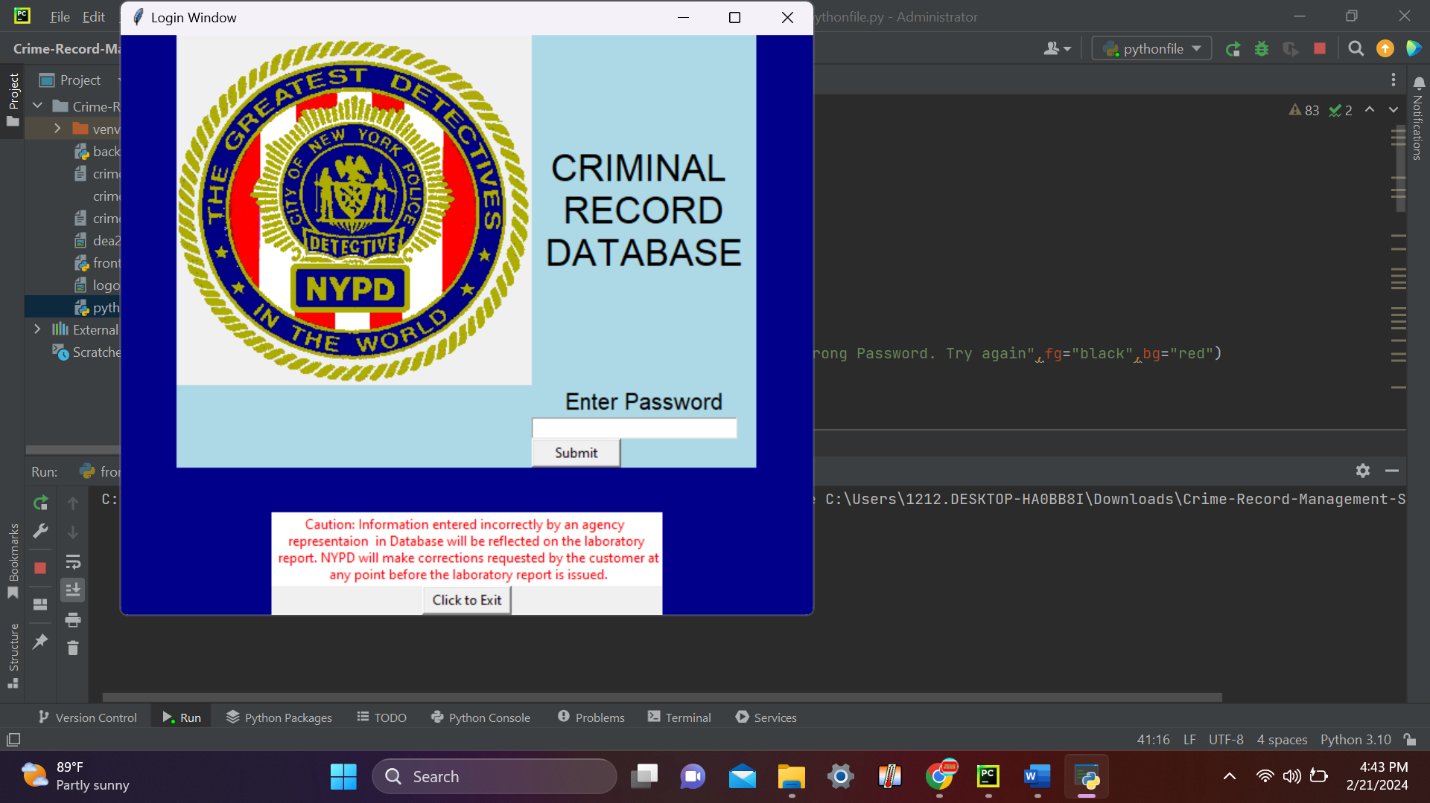
Front-End Design for Admin Login Outcome
The front-end design utilizes Tkinter, a Python GUI library, to create an interface for admin login.
It incorporates functions for user interaction, including handling button clicks, window closure, and various input fields such as labels, buttons, and entry fields.

Slide 13
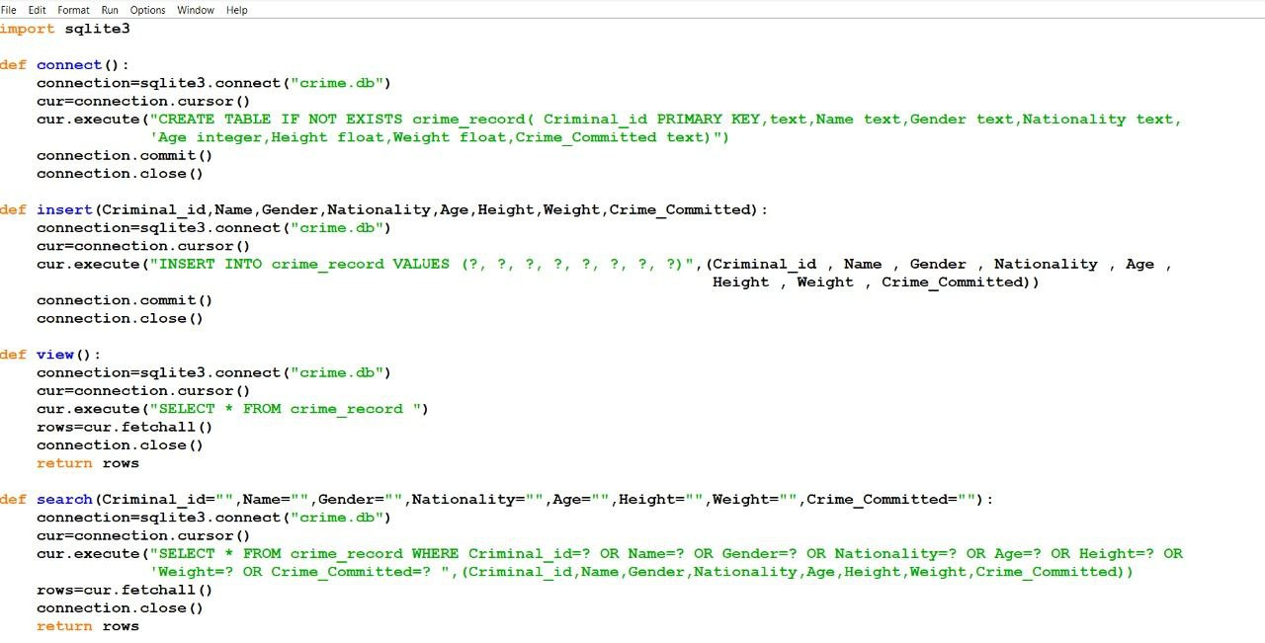
Back-end design
The code uses SQLite3 in Python to manage the back-end design of the home page, focusing on the criminal database system.
It handles various database tasks such as creating tables, inserting data, deleting records, updating records, and searching for records.

Slide 14
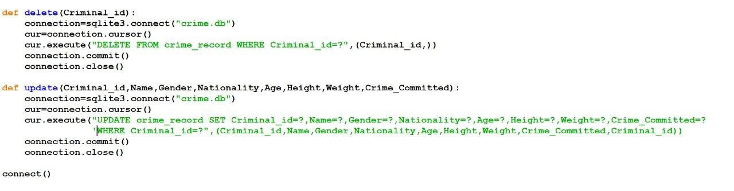
Back-end design
The print statement emphasizes the key steps of back-end database design-establishing connections, executing queries, committing changes, & closing connections-showcasing the essential structure of using SQLite3 for the home page.

Slide 15

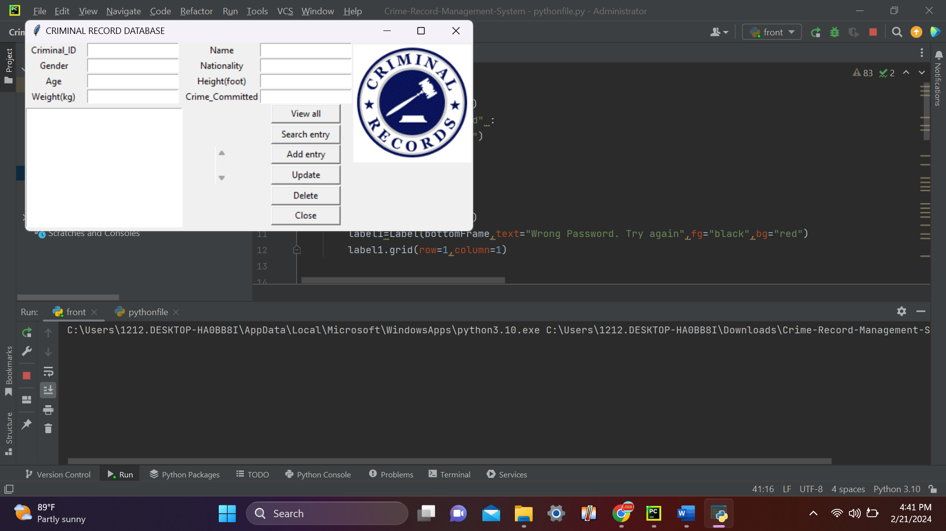
Back-End Design for Homepage Outcome
Involves the structuring and implementation of the back-end logic, ensuring the desired functionalities and outcomes are seamlessly integrated into the homepage.

Slide 16
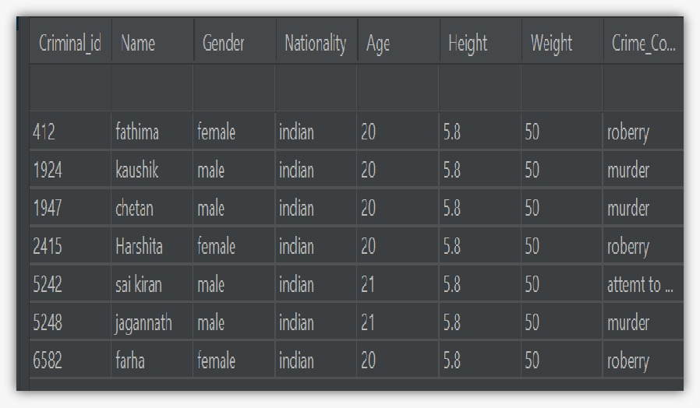
Outcomes

Slide 17
FUTURE ENHANCEMENT
Implement advanced search capabilities for complex queries based on location, criminal profiles, crime types, and case details.
Integrate data analysis and visualization tools, offering graphical representations of crime trends, heatmaps, and demographic analyses.
Incorporate machine learning algorithms for predictive analytics, identifying crime hotspots and patterns in criminal behavior.

Slide 18
CONCLUSION
Enables swift and accurate access to critical criminal data for law enforcement, legal authorities, and relevant parties.
Features like adding, searching, updating, and removing ensure the database's reliability and up-to-date information.
Integration of MySQL and Python provides flexibility, scalability, and easy maintenance.
SQL queries allow for efficient data manipulation, ensuring optimal system performance.
Serves as a valuable tool in the fight against crime by providing timely and actionable insights to stakeholders.
Acknowledges the need for continuous improvement and to meet evolving technological and law enforcement needs.

Slide 19
REFERENCE
Silberschatz Korth and Sudharshan, Database System Concepts, 6th Edition, McGraw Hill, 2013.
Fundamentals of Database Systems, Ramez Elmasri and Shamkant B. Navathe, 7th Edition, 2017, Pearson.
Database management systems, Ramakrishna, and Gehrke, 3rd Edition, 2014, McGrawHill, 2013.
https://www.w3schools.com
https://github.com

Slide 20
THANK YOU

